Slide 1

C++ PROGRAMMING
DAY 5

Slide 2
POINTERS
Pointer is a special type of variable that stores address of other variables.
The data type of pointer variable should be same as that of the variable whose address it’s going to store.

Slide 3
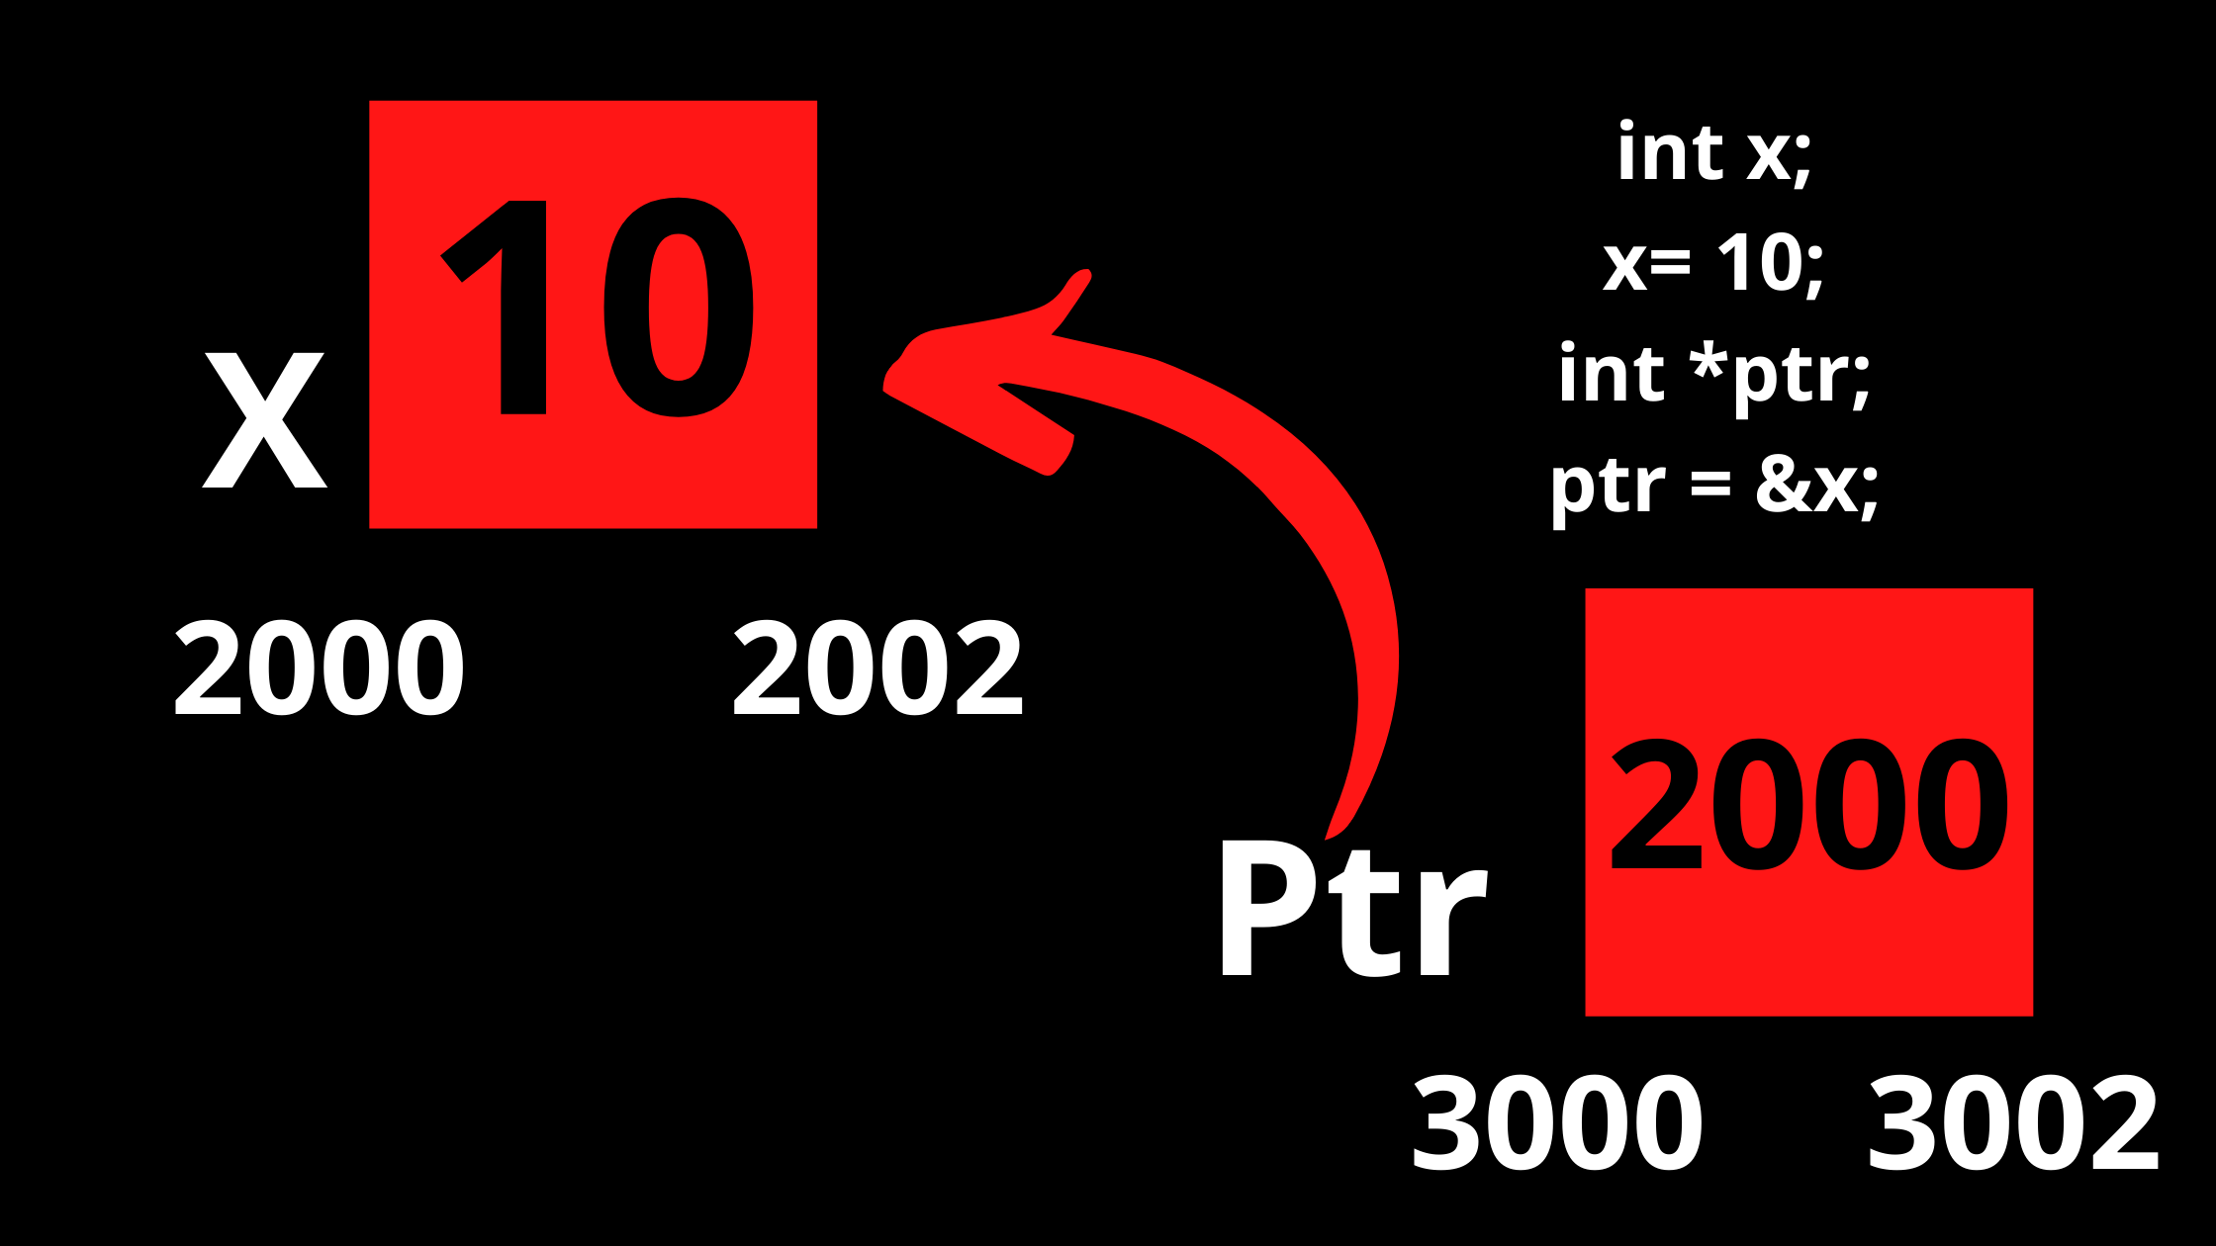
Let’s see an example

Slide 4
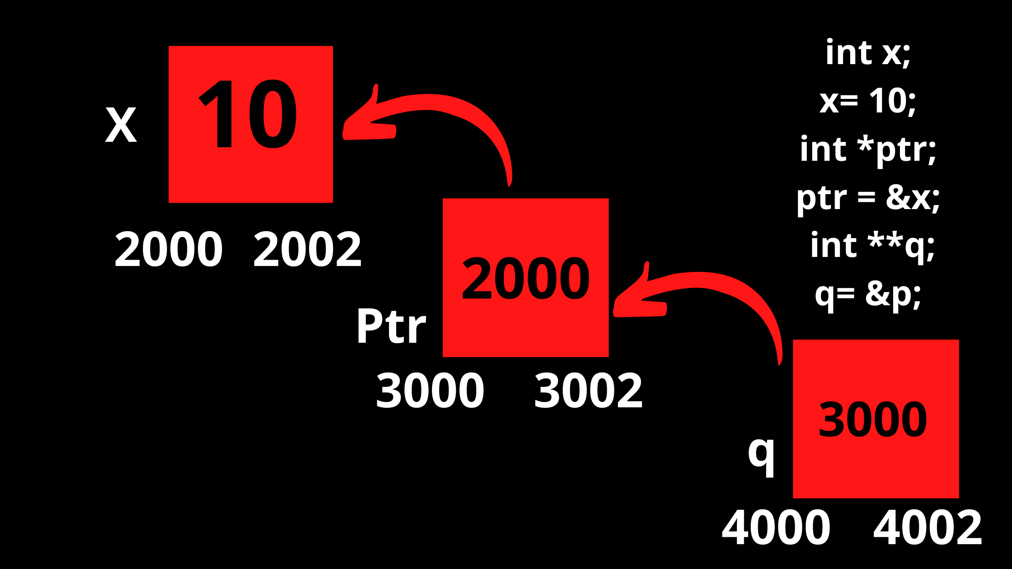
q = &ptr;

Slide 5
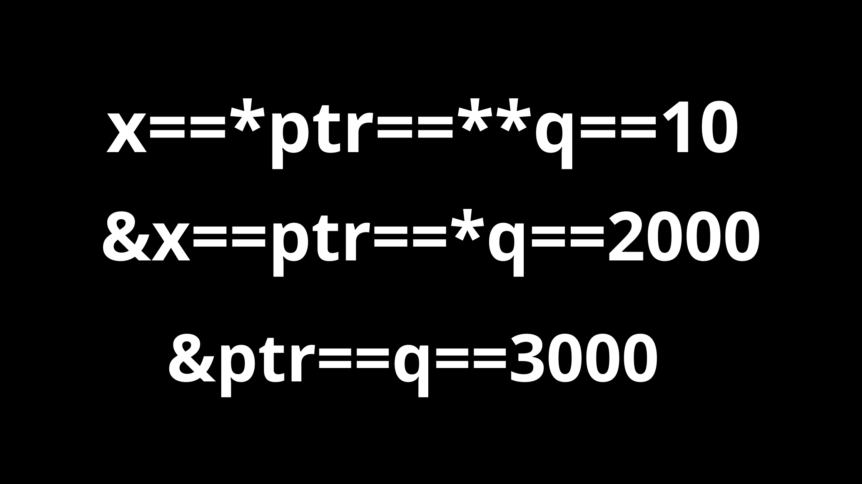

Slide 6
ARRAYS AND POINTERS
2000
1
2
3
4
5
a
a[0] 2000
a[1]
2002
a[2]
2004
a[3]
2006
a[4]
2008
a[5]
2010
int a[5] = {1,2,3,4,5 };
‘a’ is a constant pointer of type int which is pointing to very first element by storing the address of a[0] itself.
Since ‘a’ is a constant pointer we can’t modify ‘a’ like we can’t do a++;

Slide 7
&a[0]=2000
&a[1]=2002
&a[2]=2004
&a[3]=2006
&a[4]=2008
2000
1
2
3
4
5
a
a[0] 2000
a[1]
2002
a[2]
2004
a[3]
2006
a[4]
2008
a[5]
2010

Slide 8
a = constant pointer to the first element = &a[0] = 2000
a+1 = constant pointer to the second element = &a[0] + 1*sizeof(int) = 2000 + 2 =2002
a+2 = constant pointer to the third element = &a[0] + 2*sizeof(int) = 2000 + 4 =2004
a+3 = constant pointer to the fourth element = &a[0] + 3*sizeof(int) = 2000 + 6 =2006
a+4 = constant pointer to the fifth element = &a[0] + 4*sizeof(int) = 2000 + 8 =2008

Slide 9
*a = *2000 = 1
*(a+1)=*(2002)=2
*(a+2)=*(2004)=3
*(a+3)=*(2006)=4
*(a+4)=*(2008)=5
2000
1
2
3
4
5
a
a[0] 2000
a[1]
2002
a[2]
2004
a[3]
2006
a[4]
2008
a[5]
2010

Slide 10
ARRAY AND POINTERS
a[ i ] = *(a + i ) = *( i + a) = i [ a ]

Slide 11
Ways of passing an array to a function
void fun(int * x);
void fun(int x[100]);
void fun(int x[ ] );

